Slide 1
Module E-Standard Libraries
Input and Validation
Formatted Output

Slide 2
Input and Validation
Types of Input
getchar
scanf
Validation
In-Class Practice

Slide 3
Types of Input
Input to a program may be unbuffered or buffered
Interactive program uses unbuffered input. The program can respond to each and every keystroke directly.
Buffered input enables data editing before submission to a program. That is, the program accepts one complete input record at a time rather than one keystroke at a time.
A buffer is a region of memory that collects and holds data temporarily.

Slide 4
Buffered Input
To transfer the contents of a buffer to a program the user must press the '\n' character.
Two C functions provide buffered input facilities on the standard input stream:
  getchar
  scanf

Slide 5
getchar
getchar retrieves a single character from the standard input stream buffer without translating the input.
  int getchar ( void );
getchar returns either the character code for the retrieved character or EOF.
(EOF=-1, ctrl+z in Windows, ctrl+d in Unix)

Slide 6
Clearing the buffer
/* clear empties input buffer */
void clear (void) {
  while ( getchar() != '\n' )
  ;/* null statement intentional */
}

Slide 7
scanf
scanf retrieves data values from the standard input stream buffer under format control.
  scanf( format string, &identifier , ... )

Slide 8
scanf…
scanf extracts data values from the standard input stream buffer until scanf has
  interpreted and processed the entire format string,
  found a character that does not meet the next conversion specification in the format string, in which case scanf leaves the offending character in the buffer, or
  emptied the buffer, in which case scanf waits until the user adds more data values

Slide 9
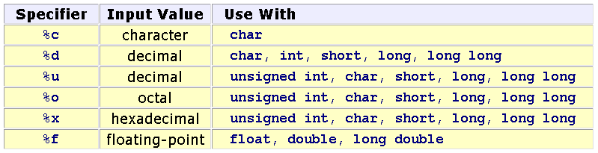
scanf …
Conversion Specifiers

Slide 10
scanf…
scanf treats the whitespace between the input values as a separator
  int items; float price;
  printf("Enter items, price : ");
  scanf("%d%f", &items, &price);
Enter items, price: 3 5.2

Slide 11
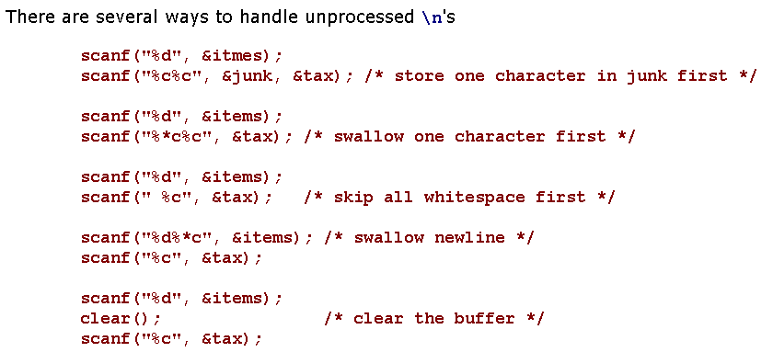
scanf…

Slide 12
scanf…
Return Values
  scanf returns the number of addresses successfully filled or EOF. A return value of
    0 indicates that scanf did not fill any address,
    1 indicates that scanf filled the first address successfully,
    2 indicates that scanf filled the first and second addresses successfully,
    ...
    EOF indicates that scanf did not fill any address AND encountered an end of data character.
The return code from scanf does not reflect success of %* conversions

Slide 13
Validation
We cannot predict how the user will input the data values: whether the user will enter them as requested or not. One user may make a mistake. Another user may simply try to break the program.

Slide 14
Validation…
We write the program so that it traps all erroneous input, which includes:
  invalid characters
  trailing characters
  out-of-range input
  incorrect number of input fields

Slide 15
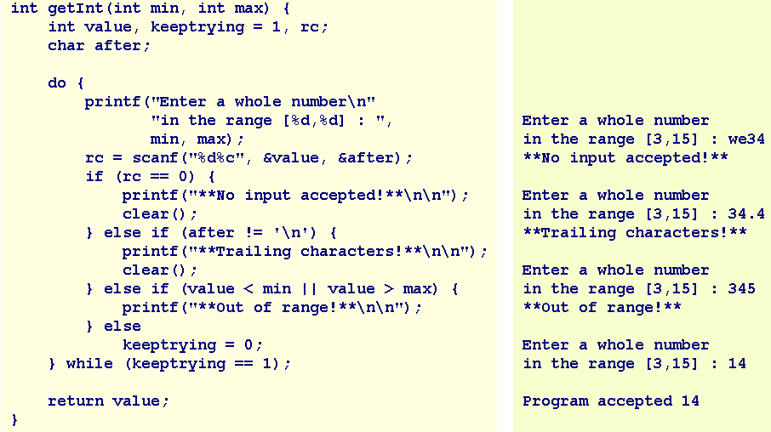
Validation…

Slide 16
In-Class Practice
Design and code a function named getDouble that receives two double values - a lower limit and an upper limit - and returns user input that lies between the limiting values. Your function rejects any input that includes trailing characters or lies outside the specified limits.

Slide 17
Summary
Input and Validation
Types of Input
getchar
scanf
Validation
In-Class Practice
Q&A

Slide 18
Formatted Output
putchar
printf

Slide 19
Formatted Output
Standard output is buffered. The standard output buffer empties to the standard output device whenever the buffer receives a newline character or the buffer is full.
Buffering enables a program to continue executing without waiting for the output device to finish displaying the most recently received characters.

Slide 20
putchar
putchar writes the character received to the standard output stream buffer and returns the character written or EOF if an error occurred.
Prototype:
  int putchar ( int );
For example:
  putchar('a');

Slide 21
printf
printf sends data under format control to the standard output stream buffer and returns the number of characters sent.
Syntax
printf ( format string , value, ..., value )
The format string is a literal string that consists of characters interspersed with conversion specifiers.
Conversion specifier begins with a % and ends with a conversion character

Slide 22
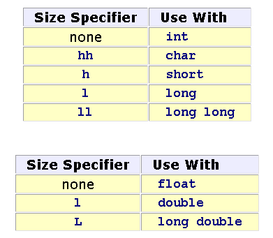
Format string
Between the % and the conversion character, there may be
% flags width . precision size conversion_character
flags
  - prescribes left justification of the converted value in its field
  0 pads the field width with leading zeros
size identifies the size of data type of the value passed.

Slide 23
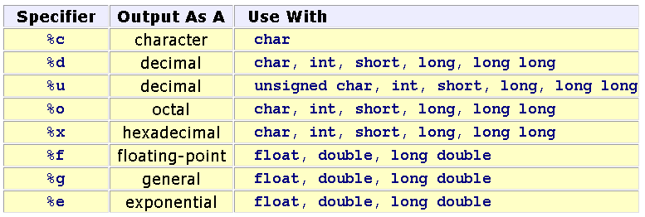
Conversion Specifiers

Slide 24
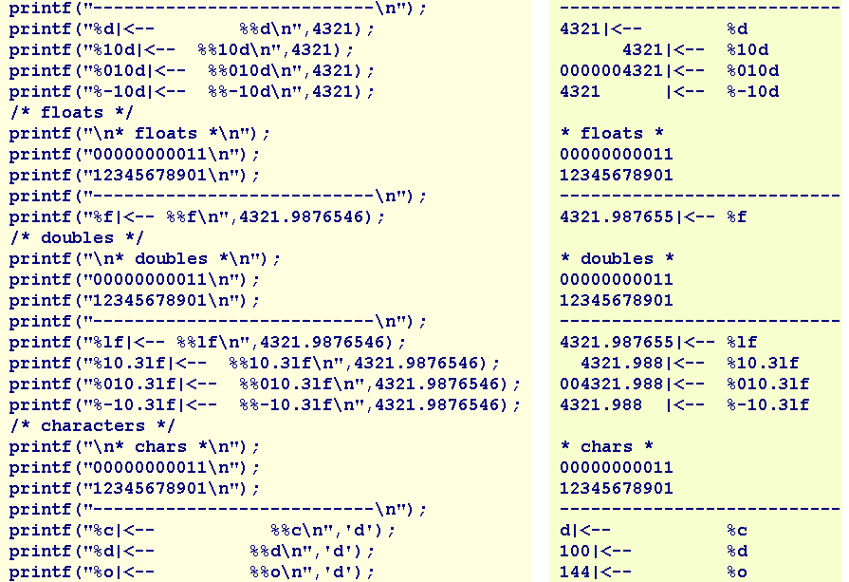

Slide 25
Summary
Formatted Output
putchar
printf
Q&A

